Slide 1
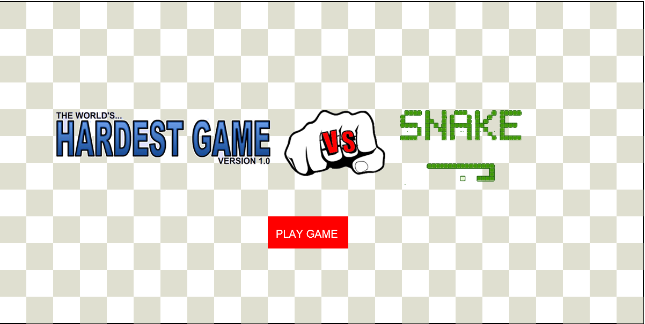
MY HTML5 Canvas Game
James Allbones

Slide 2
Overview
What is “The Worlds Hardest Game vs Snake” ?
Demonstration
Quick overview of classes/superclasses
Coding conventions

Slide 3
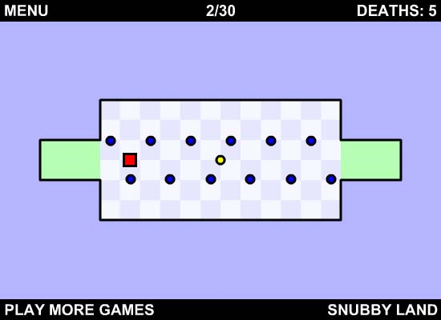
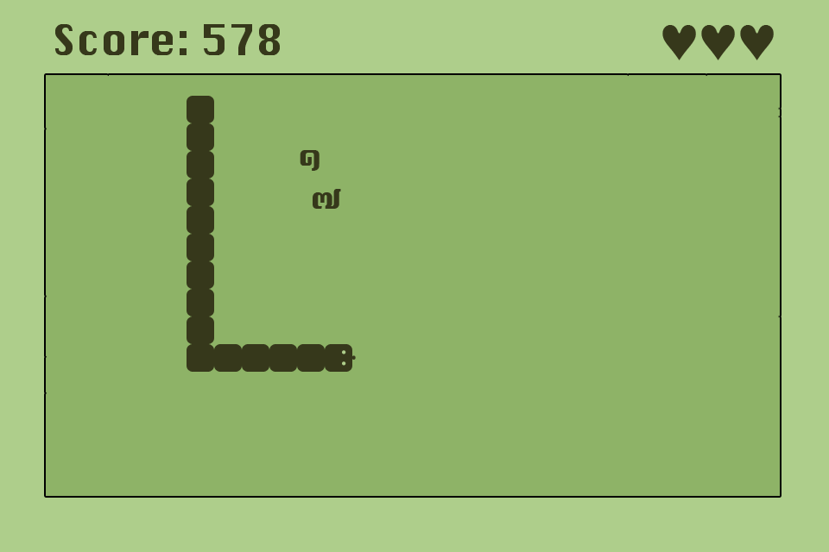
What is “The Worlds Hardest Game vs Snake” ?
It is the worlds hardest game with the movement of snake

Slide 4
Lets DEMO!
Lets Play

Slide 5
Classes and subclasses
Drawable (superclass) – Stores x and y value
Rectangle (superclass) – Stores draw(),width and height for Player and Obstacles
Background – Create the background
MoveObject (superclass) – Stores move() for player and obstacles
Button – Creates a button
Bitmap – Create a bitmap
Player – Creates the player, contains players move logic
Obstacles – Creates the obstacles, contains obstacles move logic
CompoundMoveable – initiates move() to array of objects
CompoundDrawable – iniates draw() to array of objects
Gameloop – Contains requestAnimFrame

Slide 6
My Coding Conventions
Commented where appropriate
Good variable names
Good Indentations – functions, if and loops
Removed redundant where possible

Slide 7
REFERENCES
Good Coding Conventions - http://code.tutsplus.com/tutorials/top-15-best-practices-for-writing-super-readable-code--net-8118
http://www.w3schools.com/js/js_best_practices.asp
Create Snake Movements-http://thecodeplayer.com/walkthrough/html5-game-tutorial-make-a-snake-game-using-html5-canvas-jquery
Collision Detection- James’s Example

